Slide 1
HYP3-ISCE2 WORKFLOW
NOTE 1: The workflow described in this file does not work on Windows OS.
NOTE 2: My workflow is executed in Miniconda installed on Ubuntu 22.04.
NOTE 3: Products from HYP3 can only be used with MintPy.

Slide 2
Please install and initially set up miniconda by your self
Install hyp3-isce2 (https://github.com/ASFHyP3/hyp3-isce2) following instructions below:
git clone https://github.com/ASFHyP3/hyp3-isce2.git
cd hyp3-isce2
conda env create -f environment.yml
conda activate hyp3-isce2
python -m pip install -e .
After install miniconda, create hyp3-isce2 virtual environment, and activate the environment, please run the following command:
conda install -c conda-forge pandas matplotlib geopandas contextily pyyaml openpyxl xyzservices

Slide 3
WORKFLOW OVERVIEW
Merged images can be processed with SNAP, or ISCE2
Polygon cover study area
These steps can be run idenpendently
Download bursts
Identify Sentinel-1 bursts
Run hyp3-isce2
Step 3
Generating batch scripts
Step 1
Output only used for MintPy
Step 2
Desired time span

Slide 4
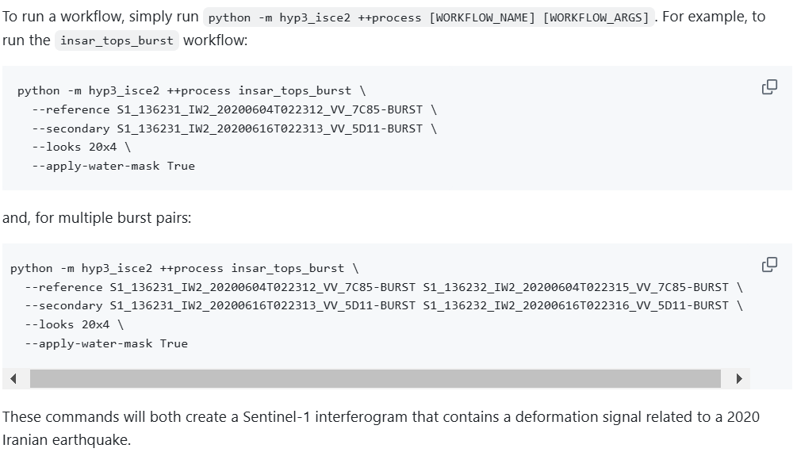
The final product is the batch scripts to run hyp3-isce2 like the instructions below
Single burst process
Multiple-burst
2 bursts on 2020/06/04, 2 burst on 2020/06/16

Slide 5
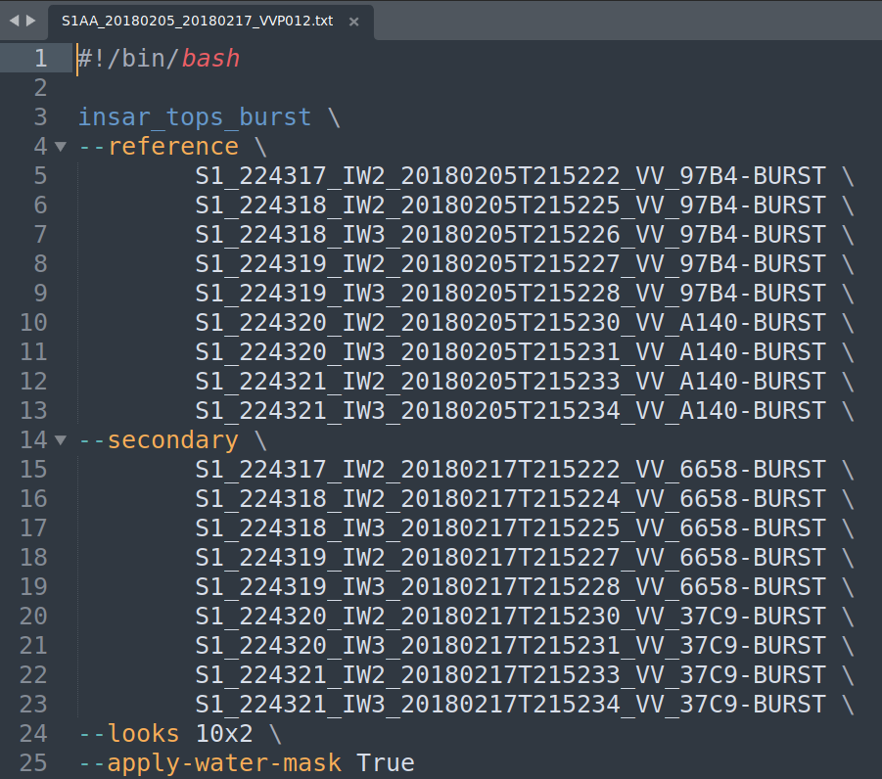
For example, here is the batch script I prepared for my processing (S1A, descending) with 9 bursts
--looks → multilooking ratio (10 range : 2 azimuth)

Slide 6
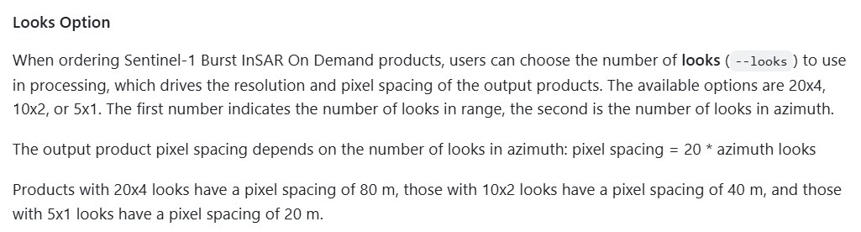
Here is the explanation for multilooking ratio from the main page of hyp3-isce2

Slide 7
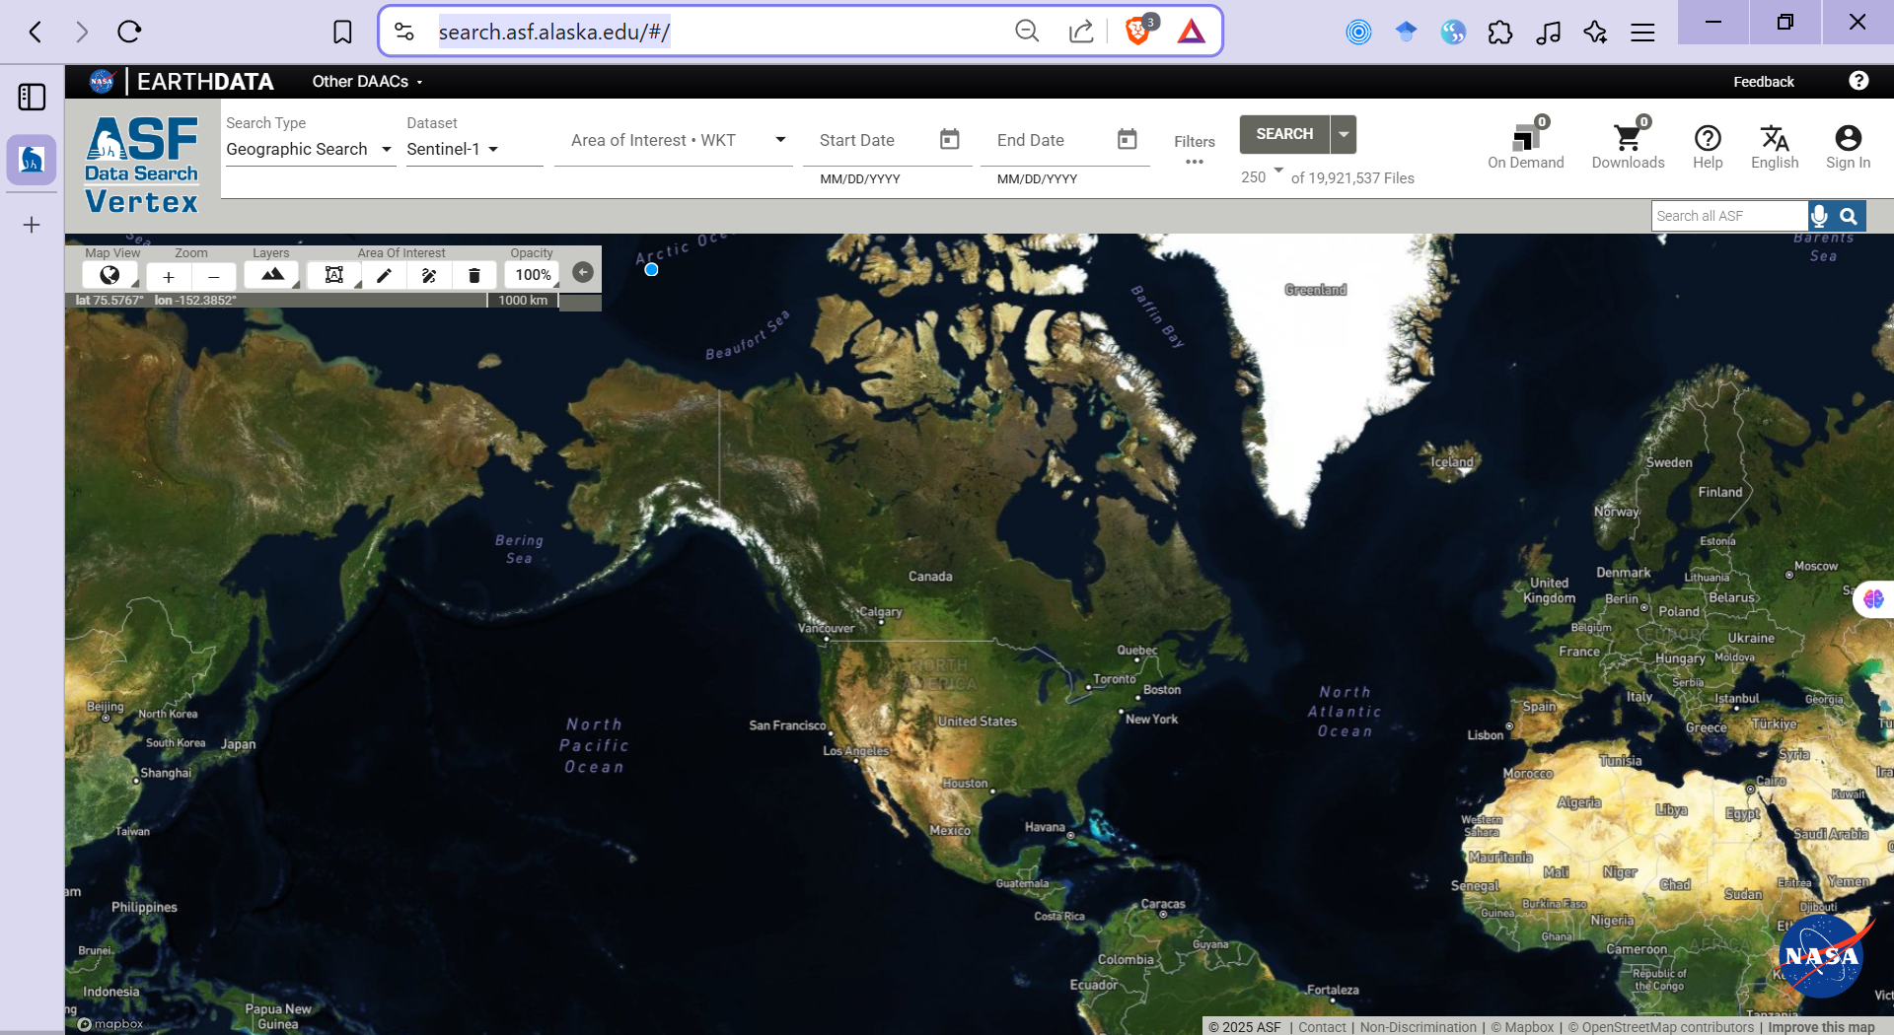
First, access https://search.asf.alaska.edu/#/

Slide 8
Select study area
2 approaches
Using your own shapefile
Drawing polygon/box

Slide 9
Using your own shapefile
Click Filters

Slide 10
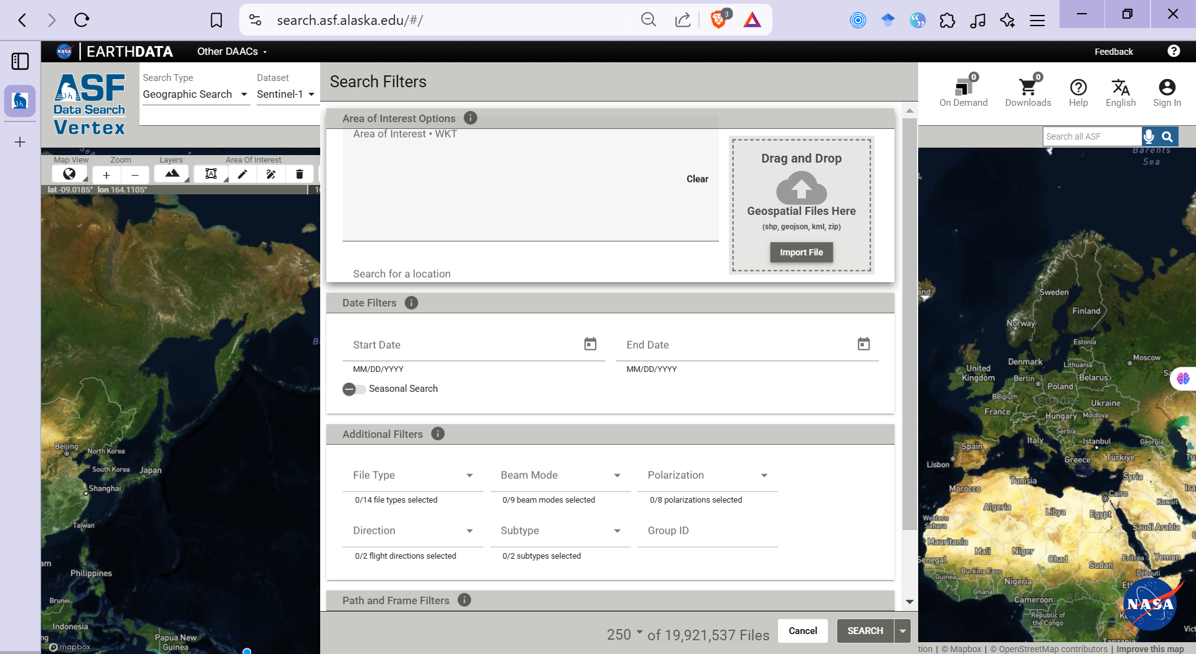
Using your own shapefile
Click Import File
geocoordinate system must be WGS84

Slide 11
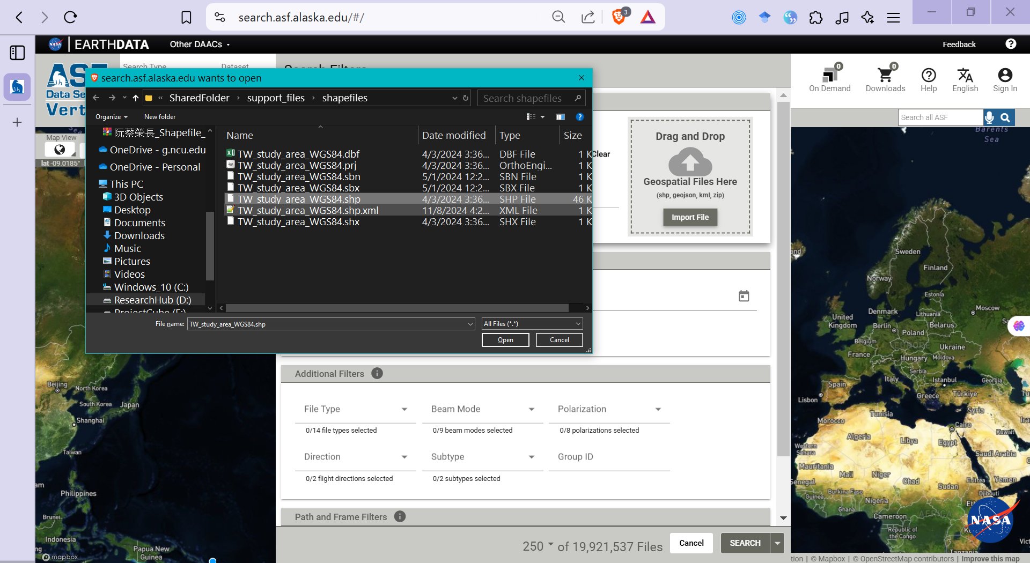
Using your own shapefile

Slide 12
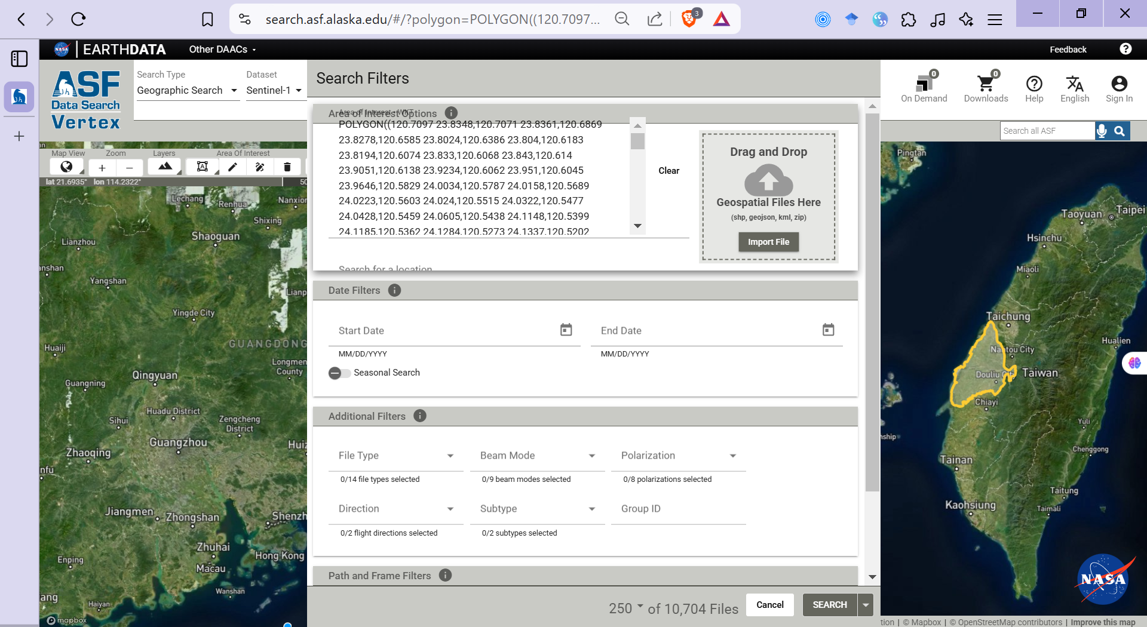
Using your own shapefile
Here is the output

Slide 13
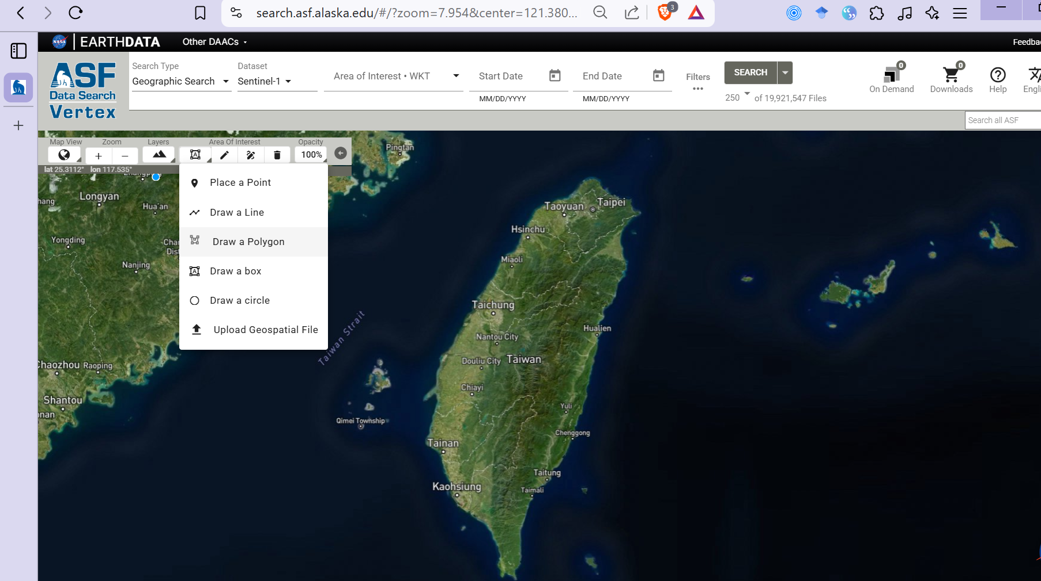
Drawing polygon/box
Click the icon
select Draw a Polygon or Draw a box

Slide 14
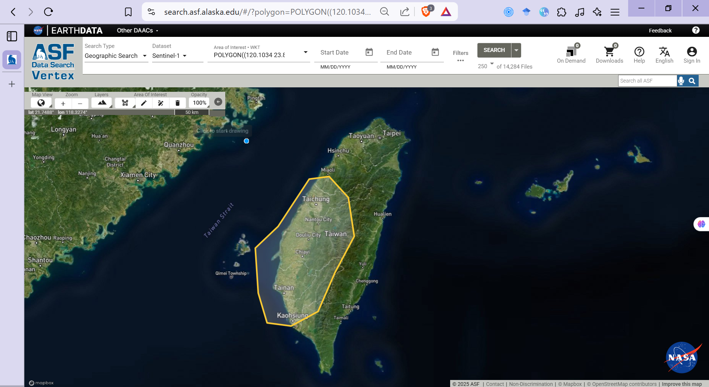
Drawing polygon/box
Draw your own polygon that covers the study area

Slide 15
From Study Area to Data

Slide 16

click Dataset

Slide 17
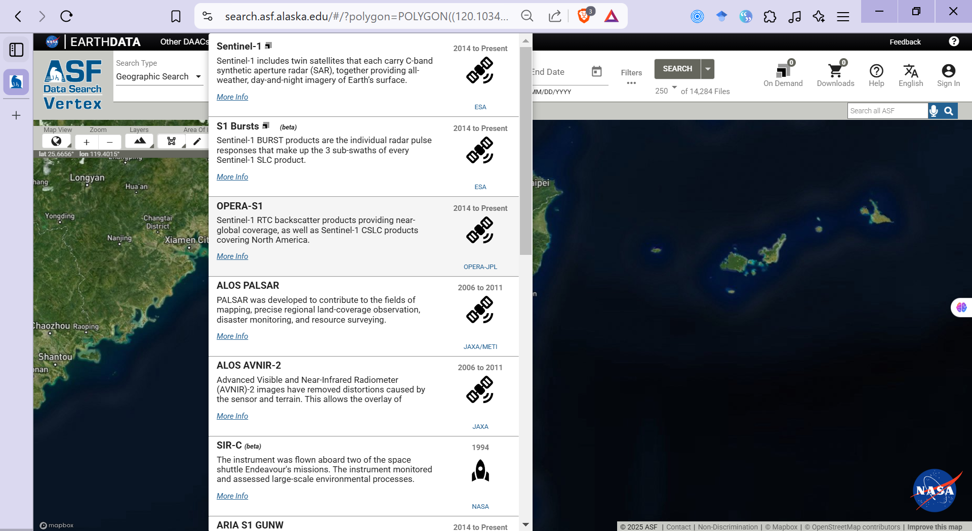
select S1 Bursts

Slide 18

choose Start Date
choose End Date
Note: Select a pair so that the temporal distance < 13 days
Because we just need to identify what bursts cover our study area

Slide 19
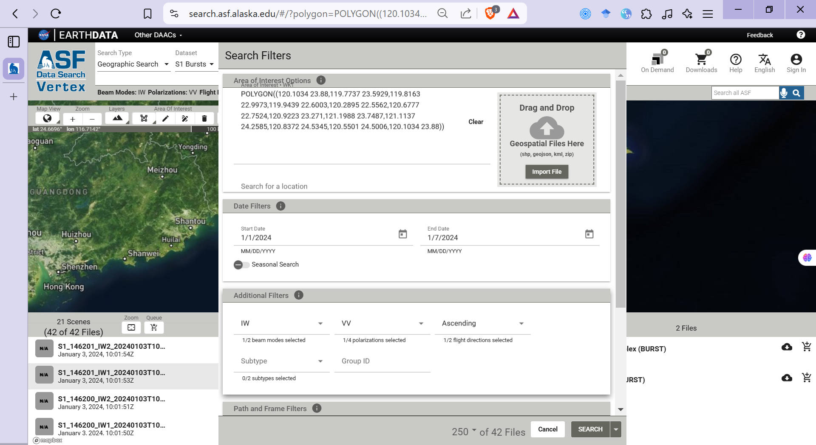
start with ascending first, same process for descending
select IW
then click Search
select polarization based on your purpose

Slide 20
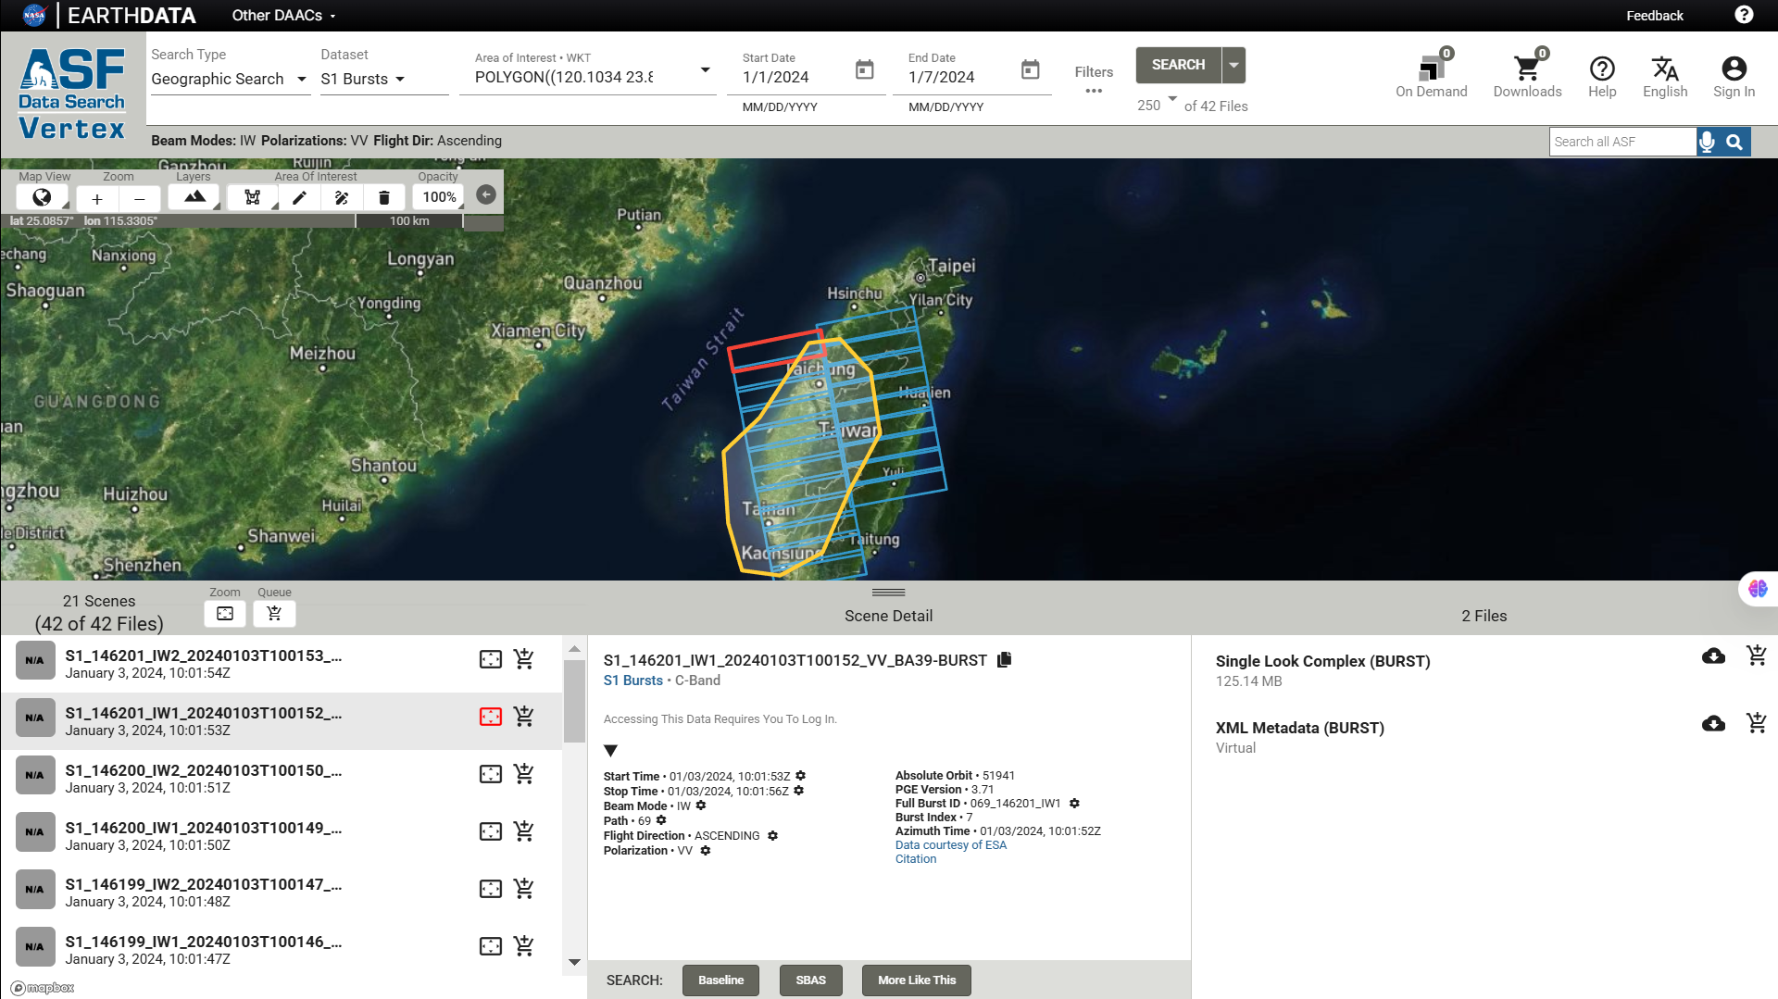
Here are the bursts covering the polygon

Slide 21
We need to notice the Full Burst ID

Slide 22
When we click the bursts along the IW1, we notice the pattern in Full Burst ID
In this case they are:
069_146200_IW1
069_146199_IW1
069_146198_IW1
…
069_146190_IW1
069 is the Path
146 is repeated

Slide 23
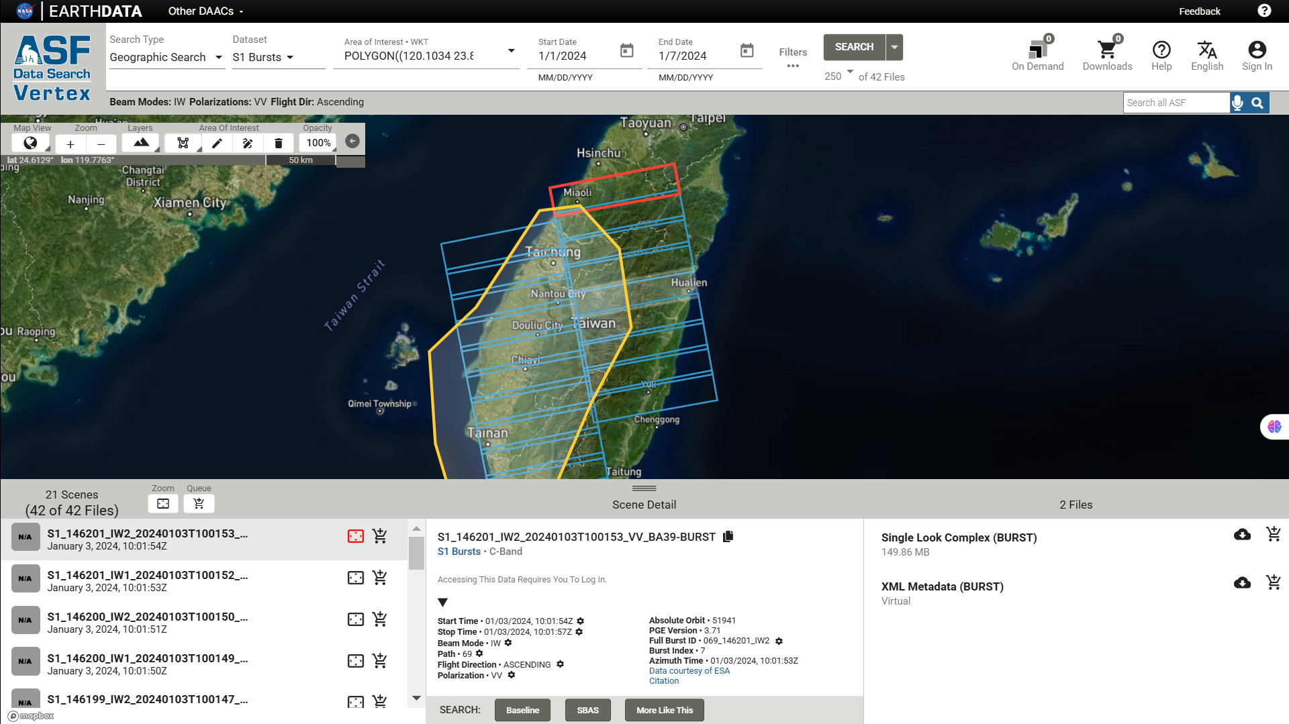
Repeat with IW2
In this case they are:
069_146201_IW2
069_146200_IW1
069_146199_IW1
…
069_146193_IW1
Based on the patterns, we will design the script to download data suitable for study area

Slide 24
An advantage when using S1 bursts instead of full SLC image

Slide 25
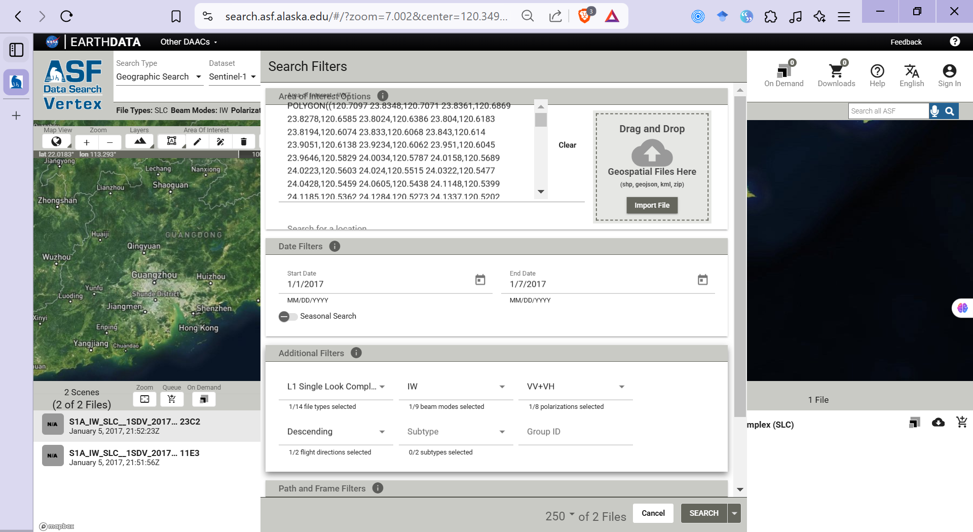
I go back to data in year 2017 for demonstration
Here is the information of SLC images covering my study area in Taiwan
I select SLC images

Slide 26
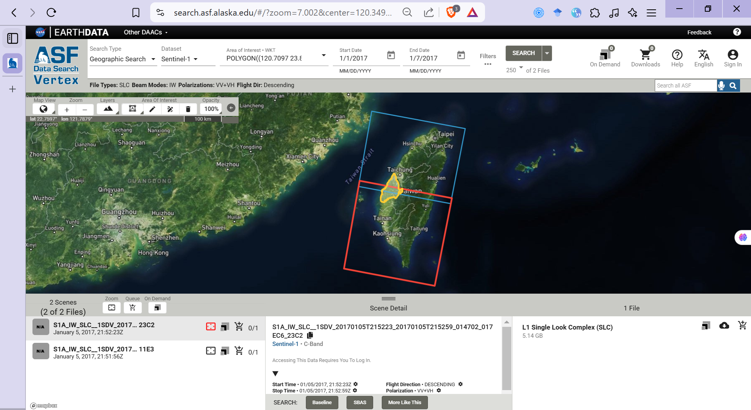
I select SLC images
My study area is covered by 2 different SAR scenes, which make it challenging for processing

Slide 27
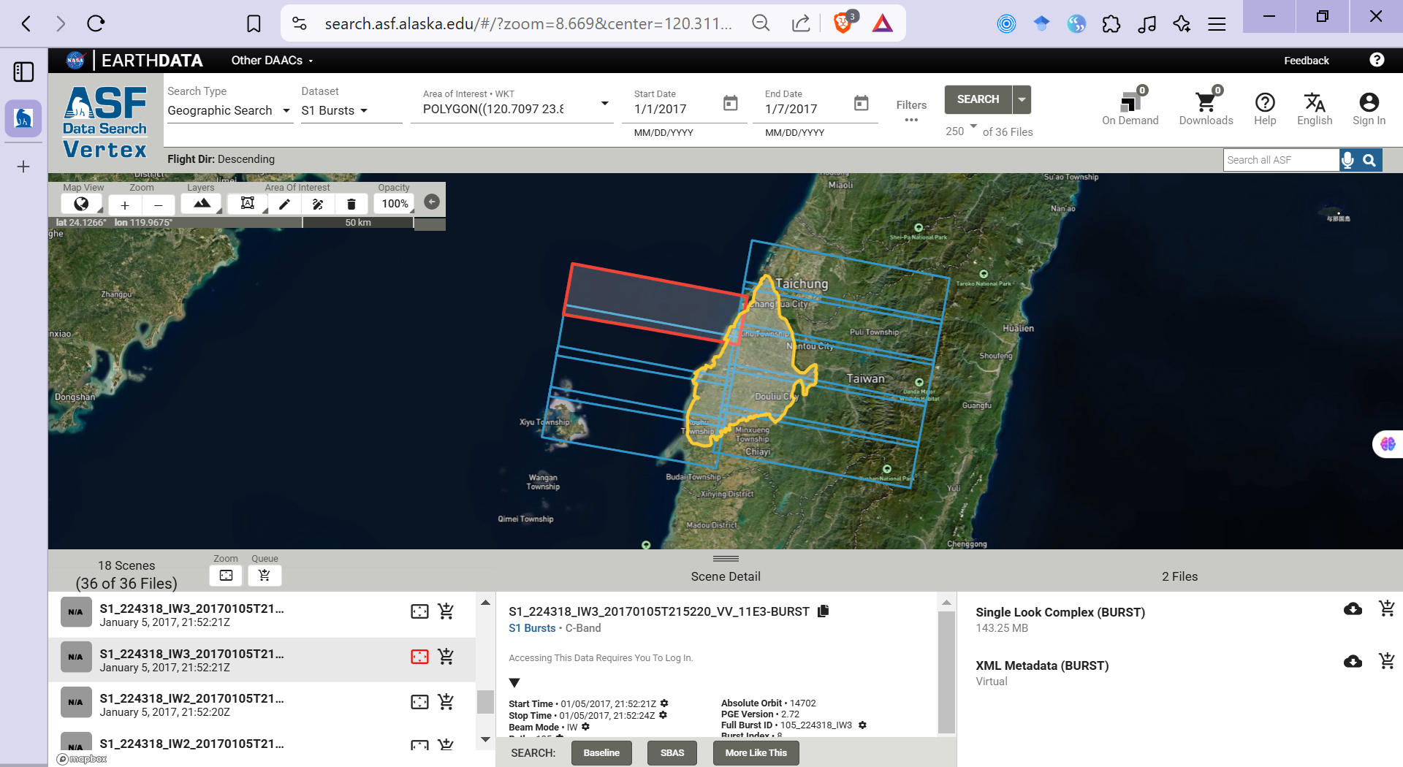
When using S1 bursts, the study area will be covered by appropriate bursts.
The bursts will be merged to generate a complete scene in hyp3-isce2 process

Slide 28
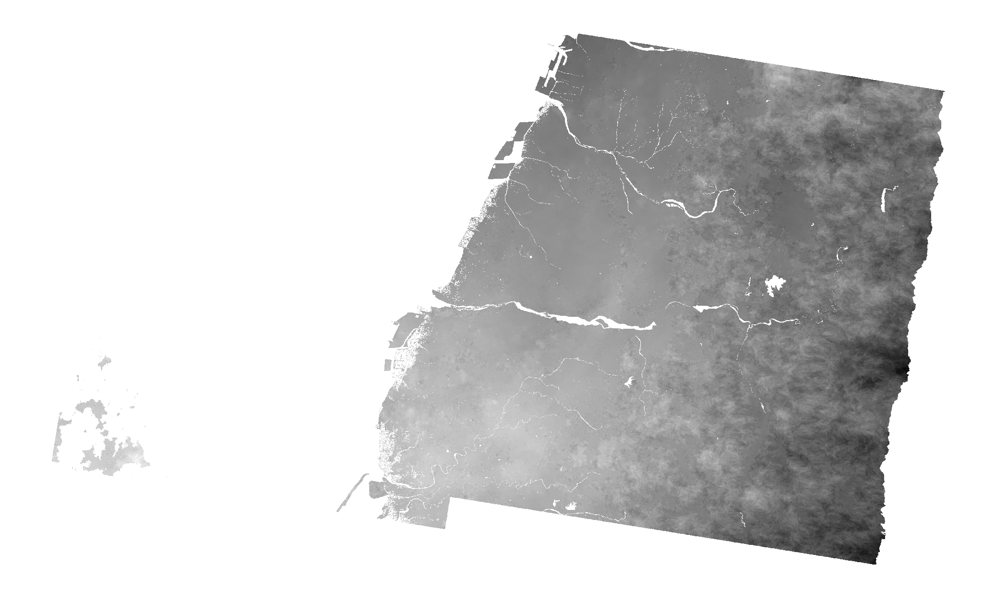
Here is the interferogram generated by hyp3-isce2 using descending bursts

Slide 29
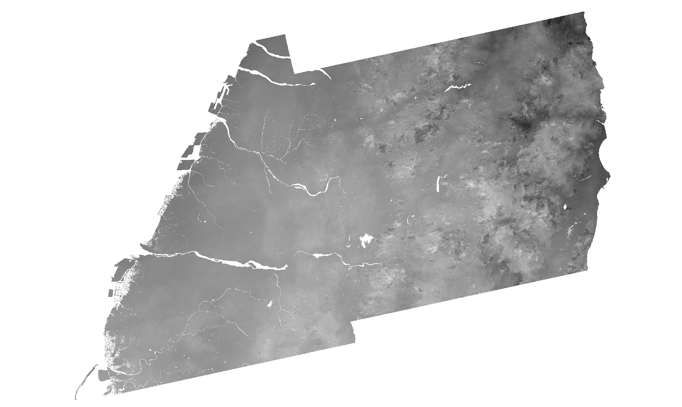
Here is the interferogram generated by hyp3-isce2 using ascending bursts

Slide 30
Before downloading data
We need a Python script to identify the Burst ID and Acquisition time range

Slide 31
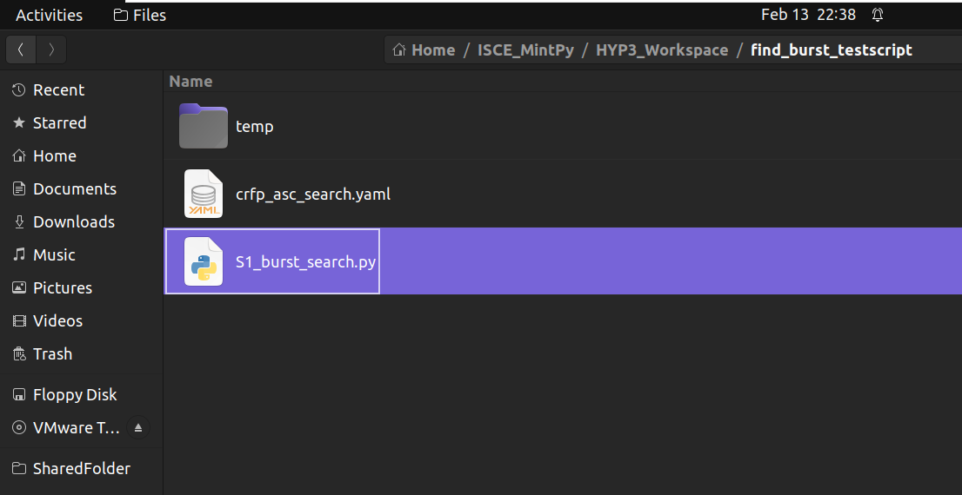
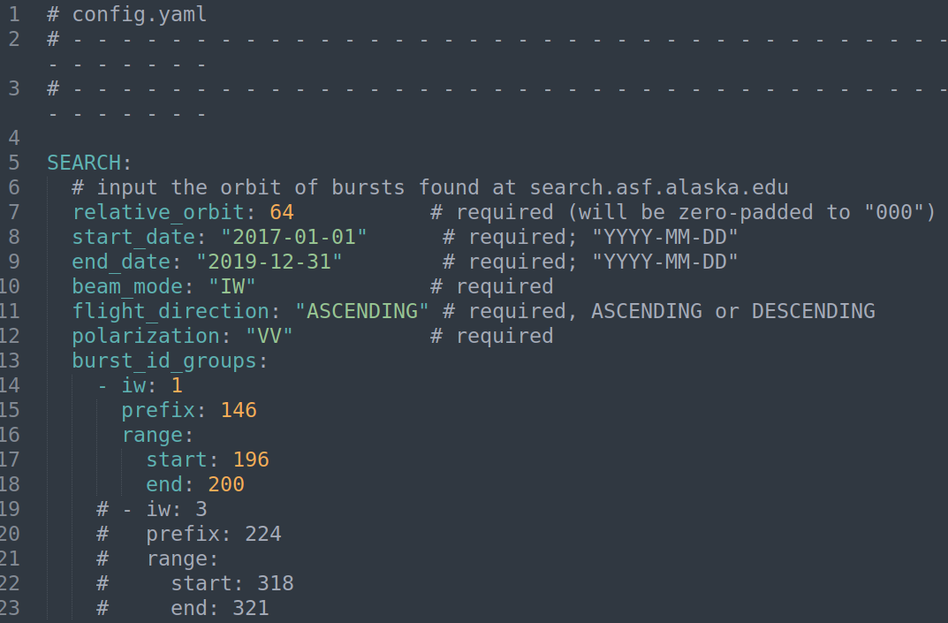
Here is a program to help users export a table of S1 bursts covering the study area within the desired time range
Users need to input parameters based on information they’ve got from https://search.asf.alaska.edu/#/

Slide 32
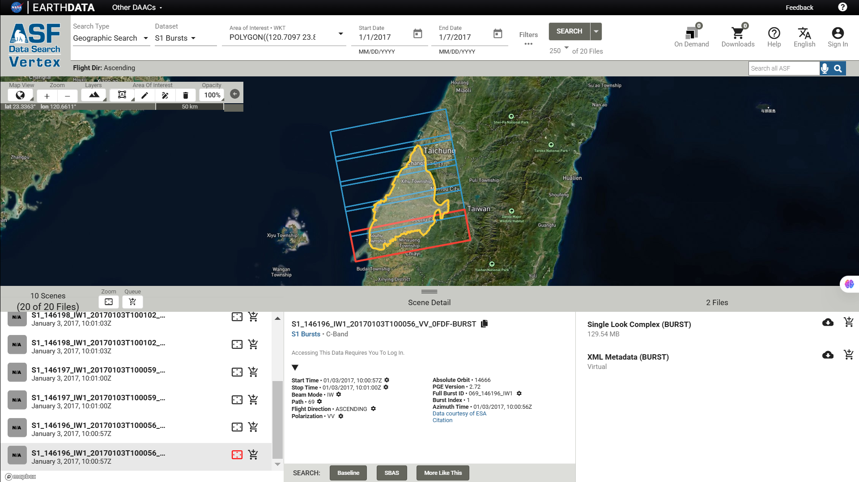
Come back to this slide for demonstration
For my study area, I would like to select 5 bursts
069_146200_IW1
069_146199_IW1
069_146198_IW1
069_146197_IW1
069_146196_IW1
200
199
198
197
196

Slide 33
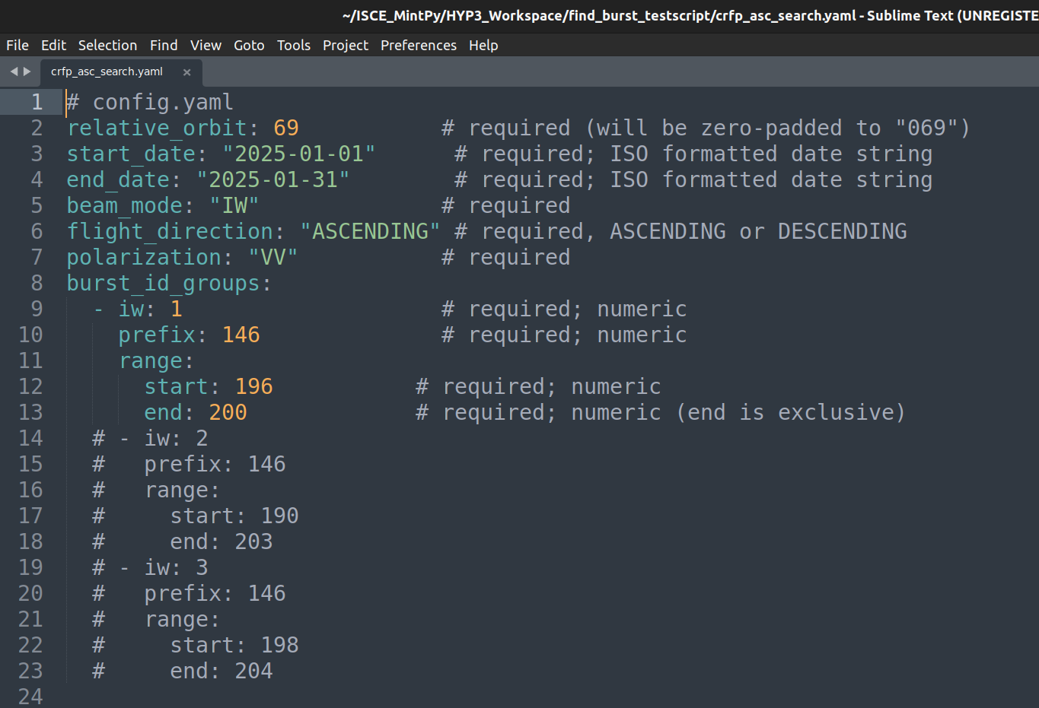
Remember to input data in the right format
Then input to the required parameters

Slide 34
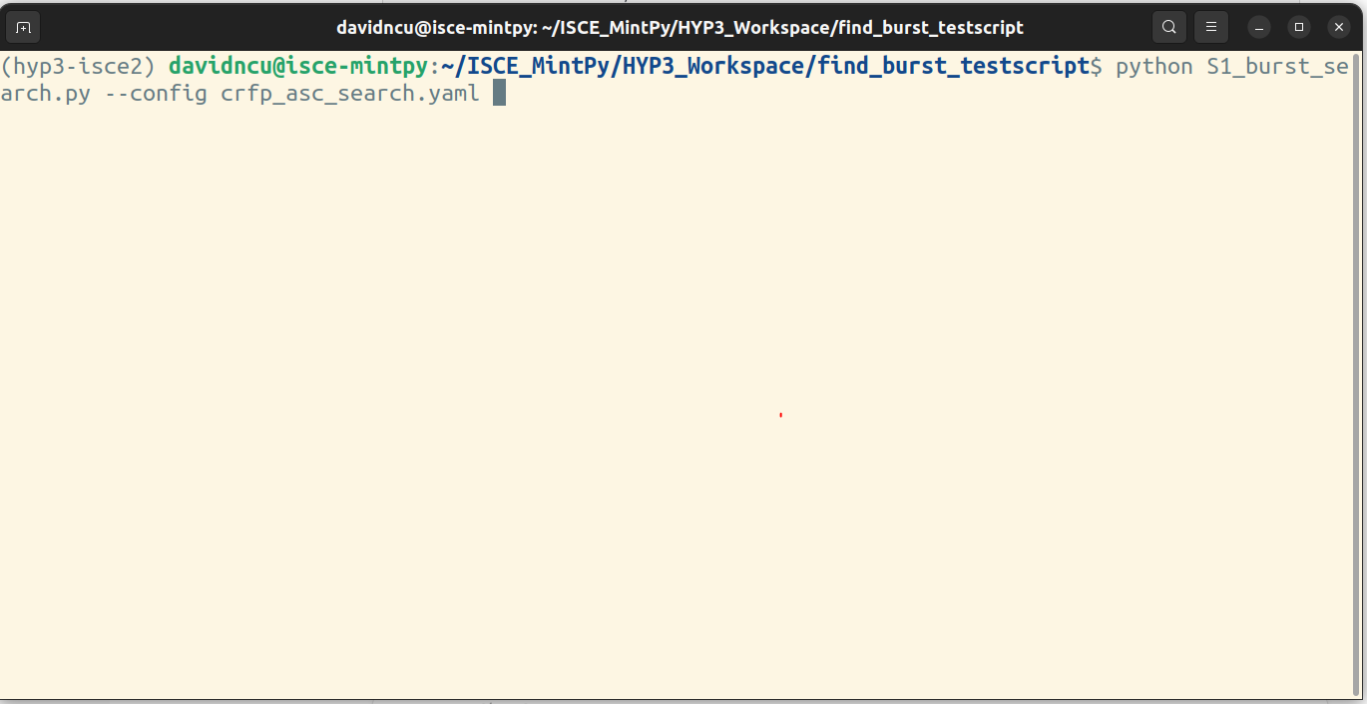
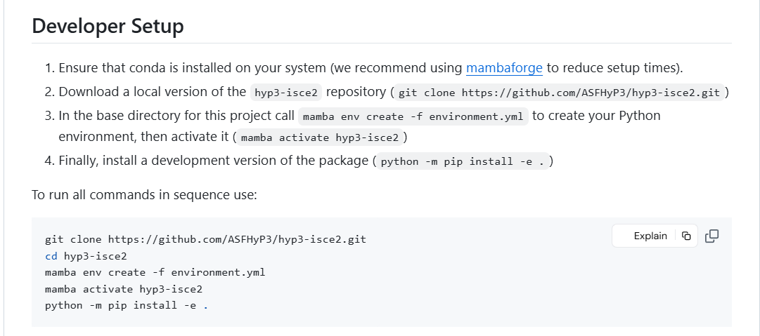
Run the following script in the command prompt
python S1_burst_search.py --config <config_filename>.yaml
Note that I run the script in the virtual environment hyp3-isce2 which was guided to install here https://github.com/ASFHyP3/hyp3-isce2

Slide 35
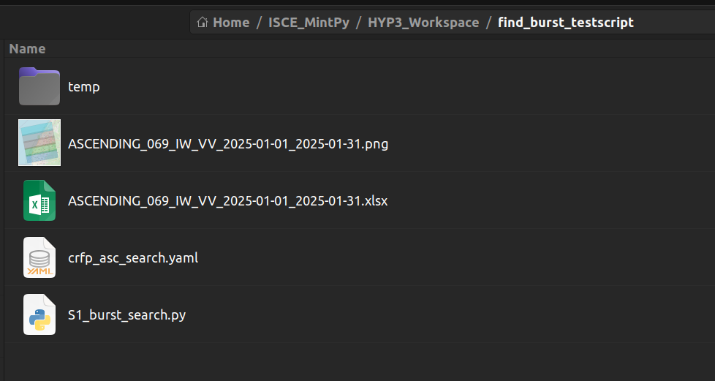
The output of the script includes an Excel file containing the bursts satisfying input parameters, and an image of burst coverages

Slide 36
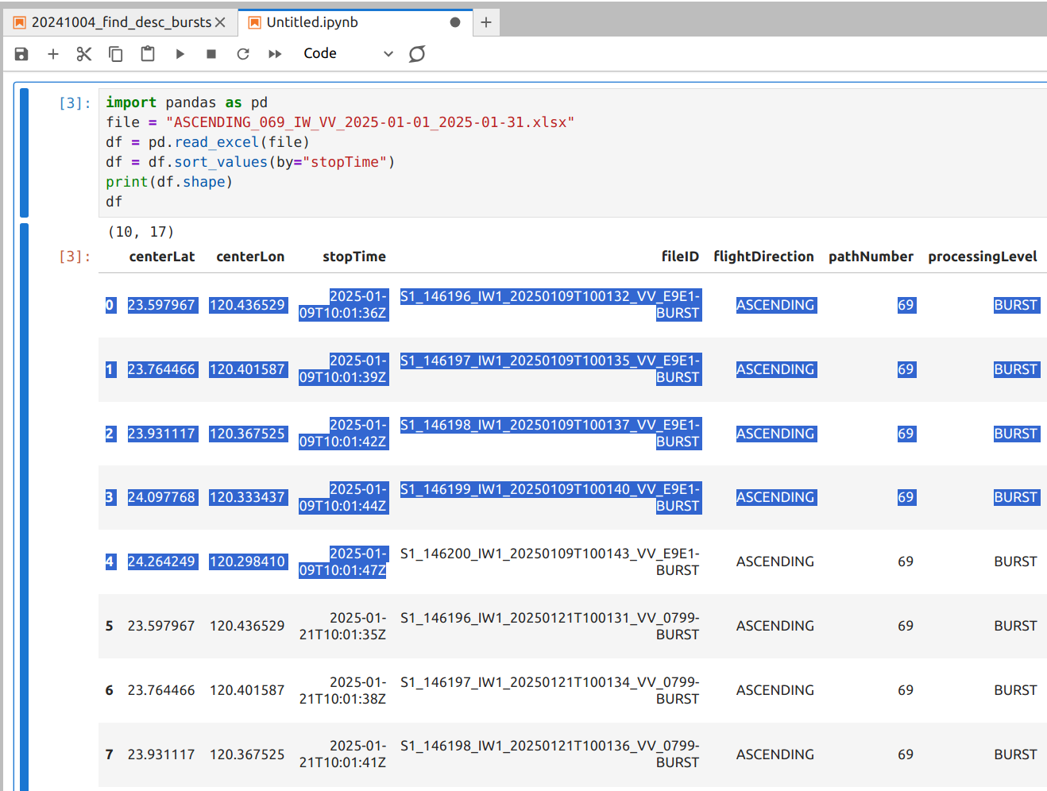
Here is the content of Excel file, including 5 bursts acquired on 2025-01-09, and 5 bursts acquired on 2025-01-21

Slide 37
Until this step, we have NOT downloaded any image scenes. We only indentify all bursts which satisfy 2 conditions:
Cover the study area
Available for the desired time span
WORKFLOW OVERVIEW
Merged images can be processed with SNAP, or ISCE2
Polygon cover study area
These steps can be run idenpendently
Download bursts
Identify Sentinel-1 bursts
Run hyp3-isce2
Step 3
Generating batch scripts
Step 1
Output only used for MintPy
Step 2
Desired time span
completed

Slide 38
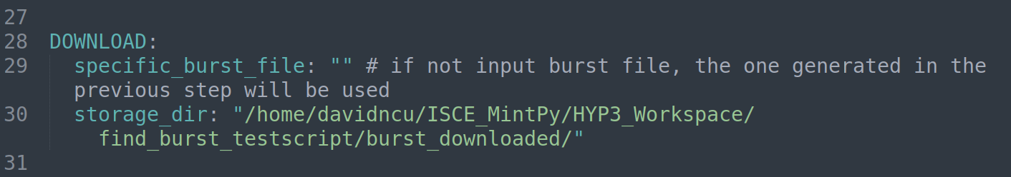
After generating the Excel file from step 1, you can run either download_bursts.py or generate_batch_scripts.py
If you want to download all bursts, please run the following command:
python download_bursts.py –config <config_filename.yaml>
The program will download bursts and automatically merge them into one complete image.
Remember to input storage_dir, the program will not run without this parameter
If you want to use another Excel file which contains other burst research results, you can input the file path to specific_burst_file

Slide 39
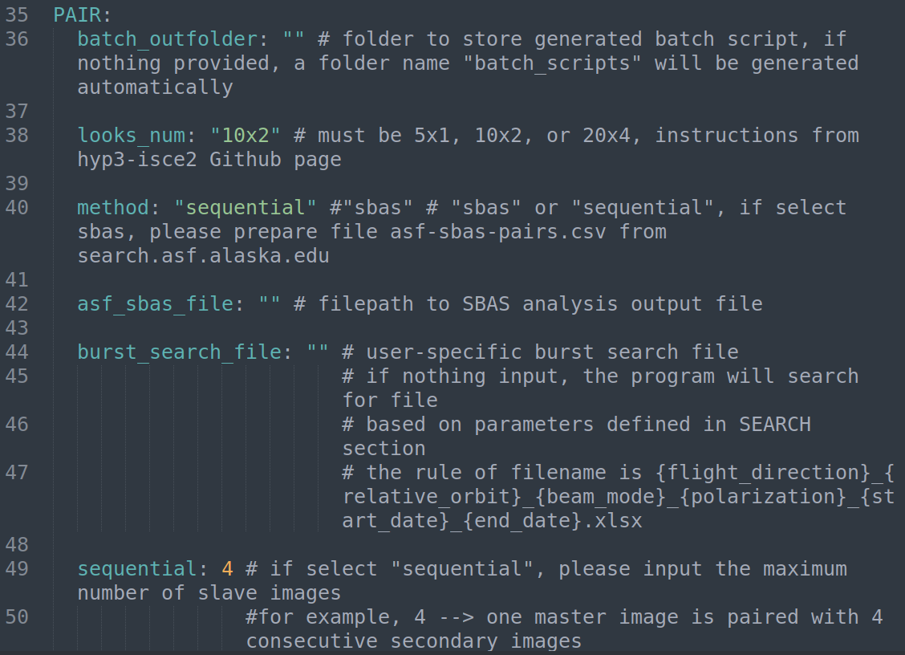
Then, we need to generate batch scripts to run hyp3-isce2, please input necessary parameters into the config file, then run generate_batch_scripts.py
python generate_batch_scripts.py --config <config_filename.yaml>
If your pairing method is “sbas”, you need to get the SBAS pair information from the ASF homepage, which will be shown in next slides.
If you need to use other burst_search_file, you can input here
If you keep it blank, the program will search for the Excel file based on input parameters in SEARCH section

Slide 40
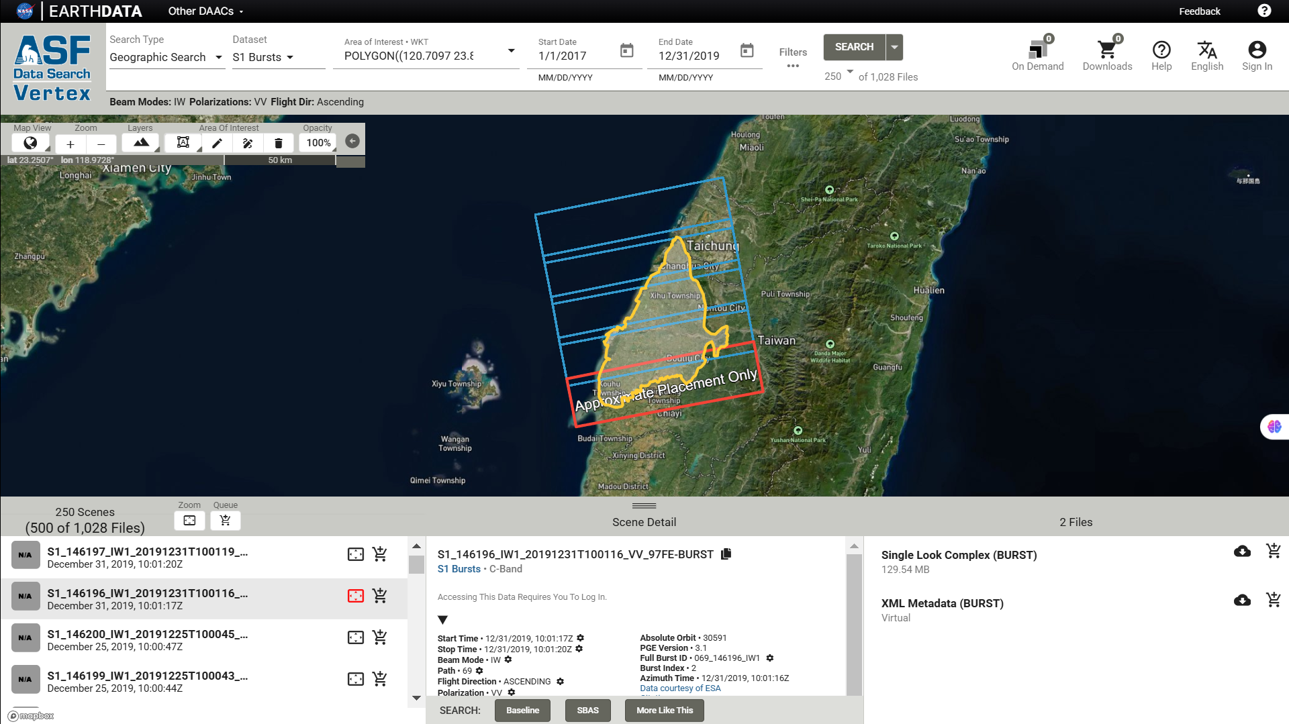
Come back to the https://search.asf.alaska.edu/#/ front page at the step Select S1 Bursts
Select a burst in your search results, then click SBAS

Slide 41
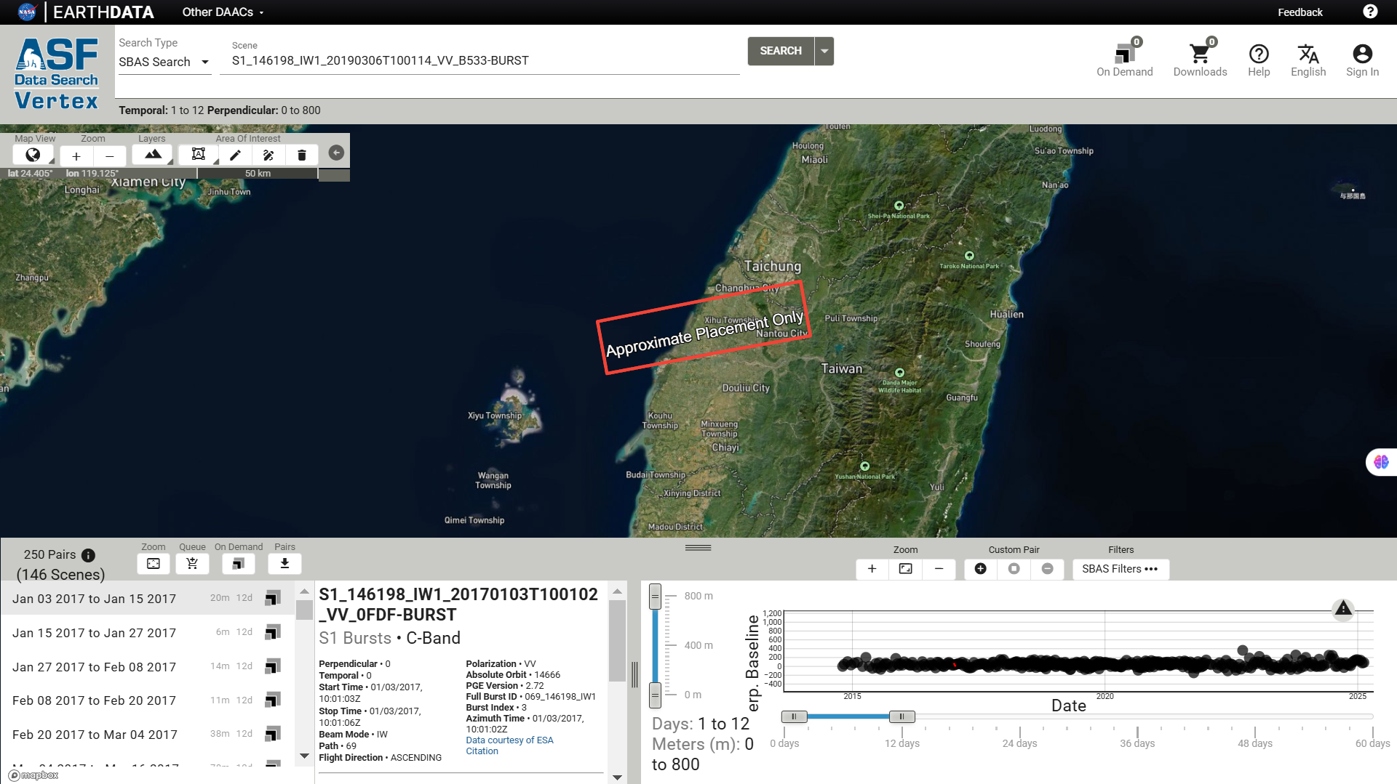
Add or remove pair by yourself
Number of pairs generated
Zoom in/out to see image connection
Adjust perpendicular baseline threshold
Adjust temporal baseline threshold
Click Download when finish selection

Slide 42
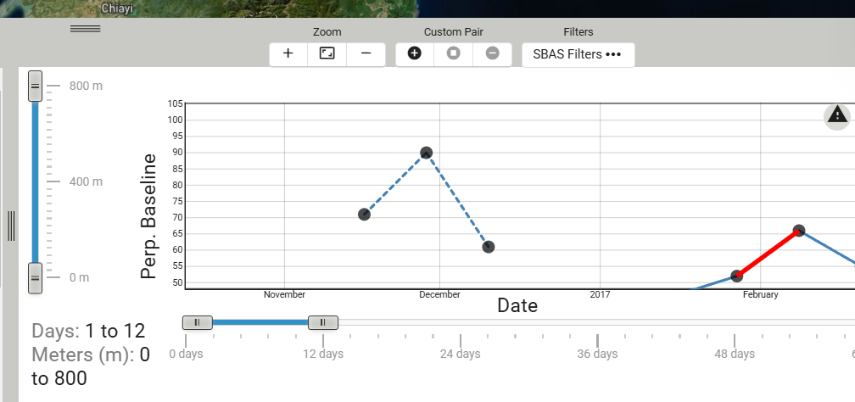
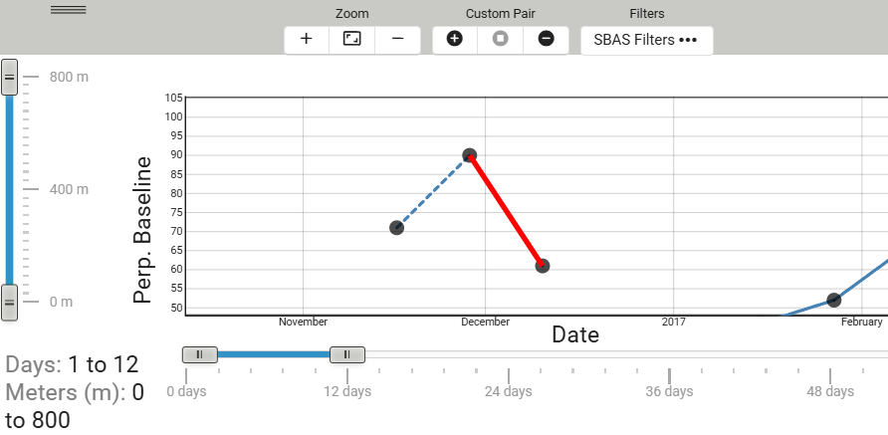
After click Download, you will get the file asf-sbas-pairs.csv, you need to provide its filepath to the config file (.yaml)
The custom selected pairs will be shown in dashed line
If you want to remove a pair, select to the dashed line, then choose Remove

Slide 43
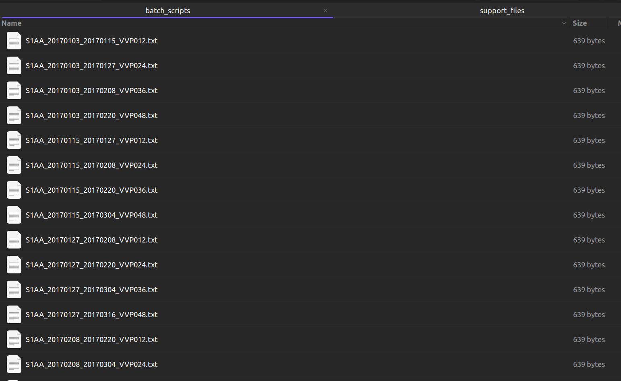
After running generate_batch_scripts.py, you will get these files

Slide 44
WORKFLOW OVERVIEW
Merged images can be processed with SNAP, or ISCE2
Polygon cover study area
These steps can be run idenpendently
Download bursts
Identify Sentinel-1 bursts
Run hyp3-isce2
Step 3
Generating batch scripts
Step 1
Output only used for MintPy
Step 2
Desired time span
completed

